Slide 1
Fire Breathing
Don’t try this at home

Slide 2
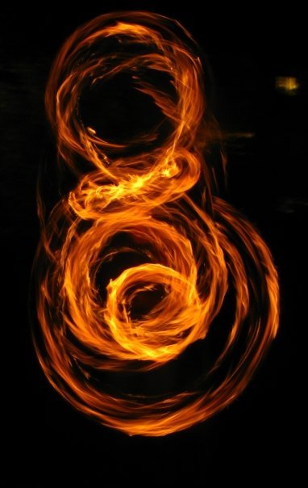
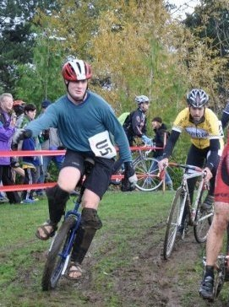
Who am I?
Alexander (@LbraryofAlexndr)
There are many paths to infosec and mine involved the circus.
Joined a fire arts circus in Portland, OR in 2006
Performed Samoan fire knife, fire staff, fire poi, fire breathing, unicycling, juggling, stilts, and slackline

Slide 3
Why fire breathing?
Pros: You get to be a dragon, it’s portable, great for parties, it’s easy, and looks fantastic if photographed correctly
Cons: Terrible, terrible bodily harm--skin irritation, dry mouth, gum disease, stomach ulcers, poisoning, chemical pneumonia, acute respiratory distress, oral and dental problems, fuel poisoning, dry cough, headache, dizziness, abdominal pains, diarrhea, nausea, vomiting, loss of taste, severe burns, cancer, death, and most people are really bad at photographing it

Slide 4
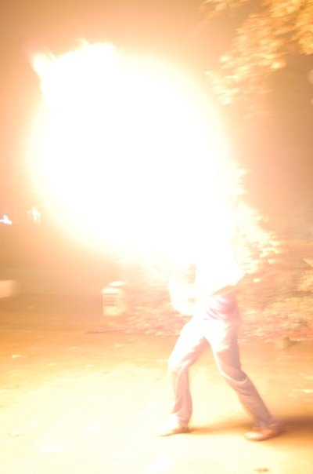
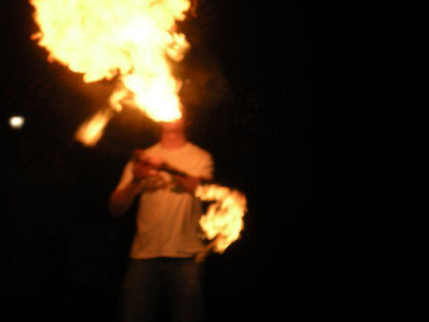
Photos are usually washed out

Slide 5
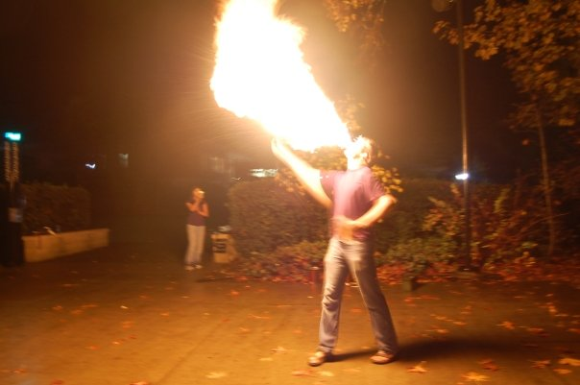

Slide 6
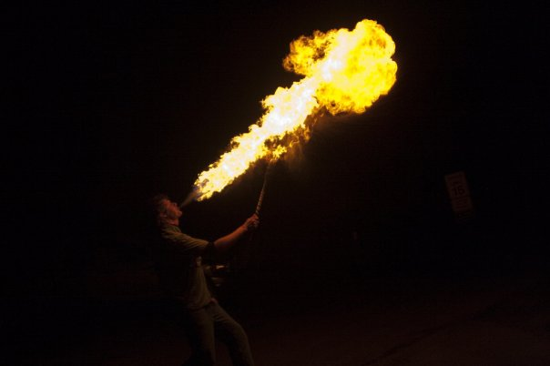

Slide 7
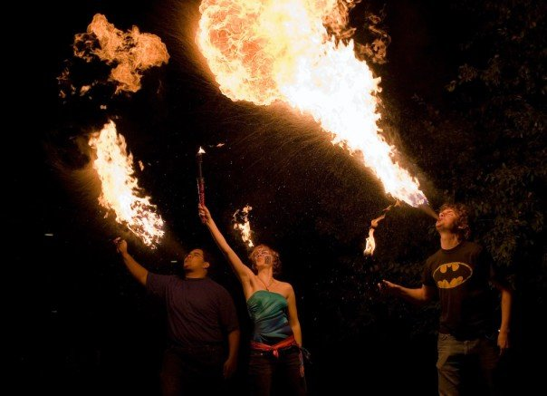

Slide 8
The Technique
Pressure + Fuel + Flame Source = Dragon
Pressure: Spray the fuel as fine a mist as possible (atomization) and as much volume of fuel as you can without producing any big droplets. If you play brass instruments--that embouchure will translate to a kickass fireball.
Angle: 60-80 degrees-- too low and you risk torching your body, too high and unignited fuel can land on your face
Flame Source: needs to be long enough to keep your hands safe (no matches/lighters)

Slide 9
Fuel
Good Fuel: Pure lamp oil (paraffin), high flash point, low toxicity (if you get the one without additives)
Bad Fuel: naphtha, aka white gas, Coleman fuel or lighter fluid --it has a low flash point, making it more volatile and more likely to burn the performer. It is also toxic.
Alcohol: methyl alcohol is extremely toxic, and ethyl alcohol allows drunkenness, which should never be combined with fire performing. Both alcohols also have extremely low flashpoints, which make them very dangerous to work with.
Volatile fuel is more likely to cause blowback--where the flame burns its way to your mouth faster than you can spray.
What if you screw up and ingest fuel? Drink milk or take some antacids before performing and eat bread after to help soak up the fuel and pass it out of your system.

Slide 10
Why practice with water?
It is a lot harder to burn your eyebrows off with water
You can see the water mist in the air and see if any large droplets hit the ground
If the spray is not fine enough, the fuel will catch fire, fall to the ground, and light the ground on fire. This requires practice and water makes this survivable.
Get into the habit of spitting any excess water that you don’t use—if you get used to swallowing the water, you’ll do it with the lamp oil.
Don’t store the oil in a water bottle (I speak from experience on this)

Slide 11
Basic Safety
Know your environment (people, pets, flammable materials)
Watch your flame source for subtle changes in air movement
Have a trained fire safety who knows: how to use a damp towel/fire blanket, first aid, location of the nearest hospital, access to fast transportation
There are way more safety considerations than can fit on these slides, so read the following:
Read this and this and this

Slide 12
Will you show us some real fire breathing now?
No. I will not. I’ve lost 2 beards to this shit and I’m not losing a third.
I only perform with a trained safety who I trust.
Even the professionals have bad days, and it can be rough
I don’t risk serious bodily harm for free.
If you still want to try this out, here is the fuel I use

Slide 13
Credits:
-personal experience
-some content ripped directly from https://entertainment.howstuffworks.com/arts/circus-arts/fire-breathing.htm
and https://en.wikipedia.org/wiki/Fire_breathing

Slide 14
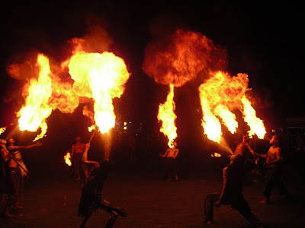
Questions?

